Slide 1
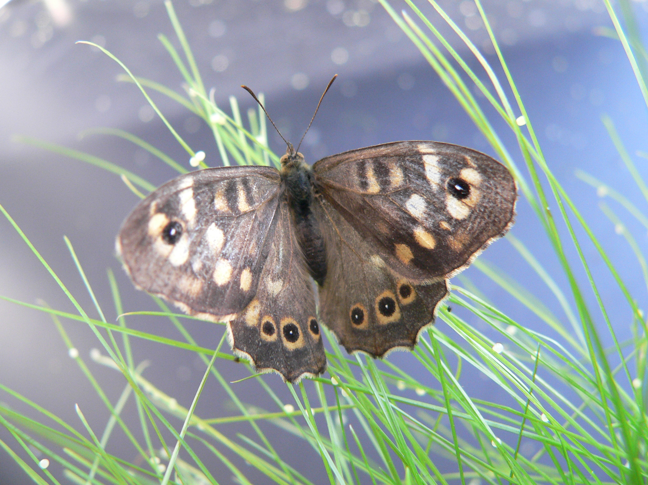
Butterflies and moths and their habitats
Casper J. Breuker & Melanie Gibbs

Slide 2
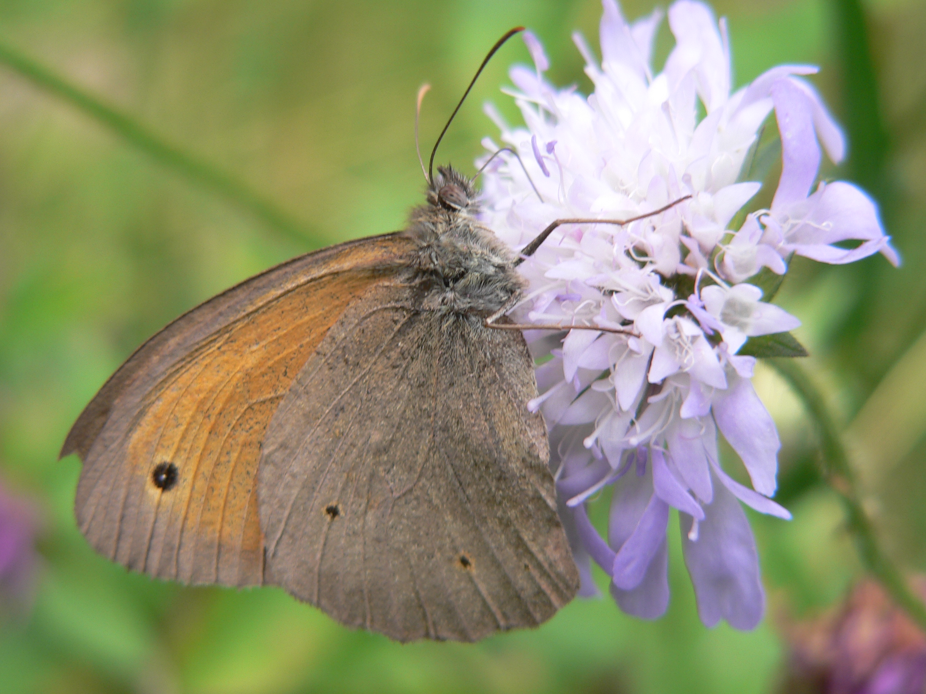
Butterflies and moths are insects
They can be found in many different types of habitats:
Grassland
Woodland
Gardens and parks in towns/cities
Farmland
A habitat is a natural environment or home
for many different types of living things like
plants and animals
A suitable habitat is one that provides
The right types of food
The right amount of food

Slide 3
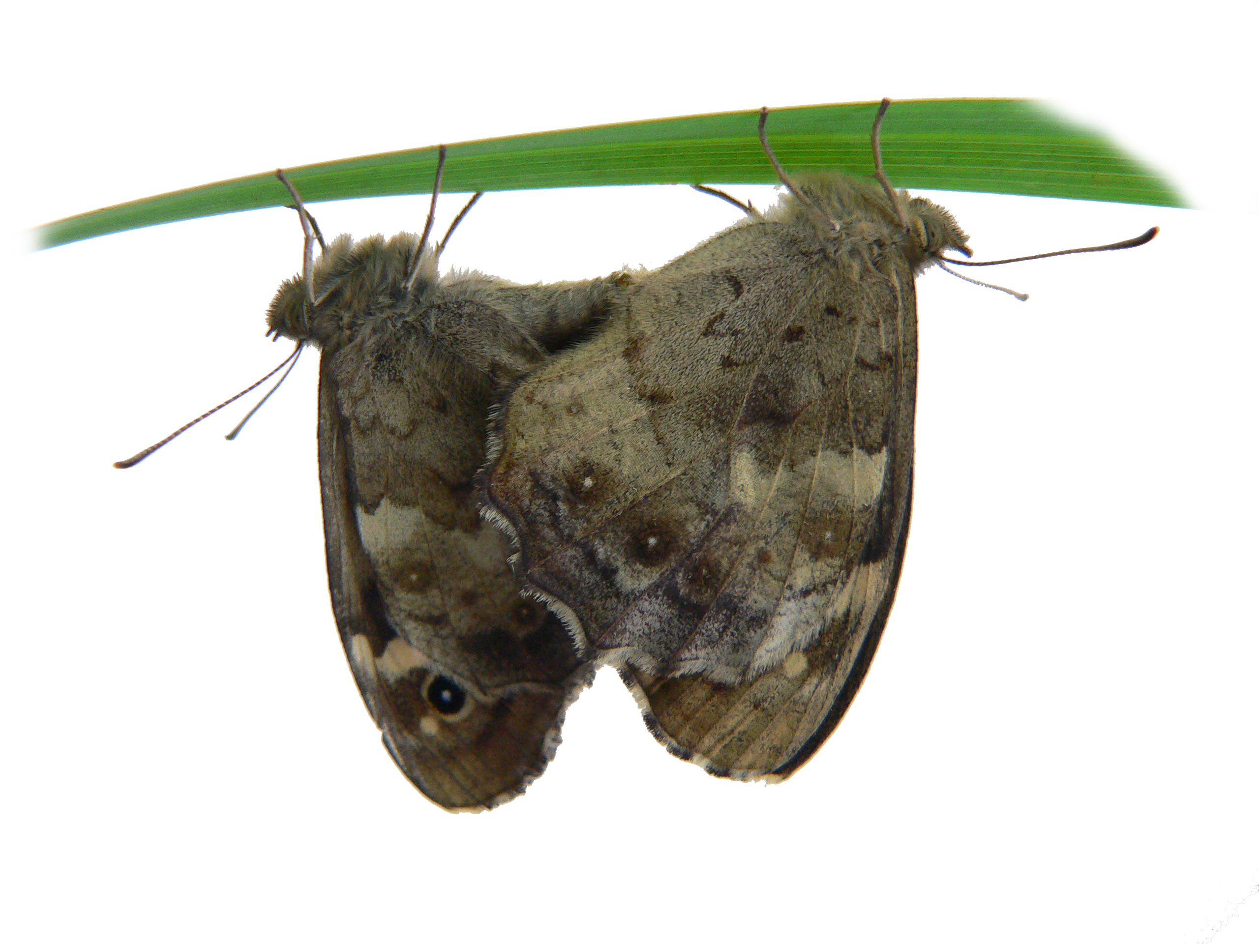
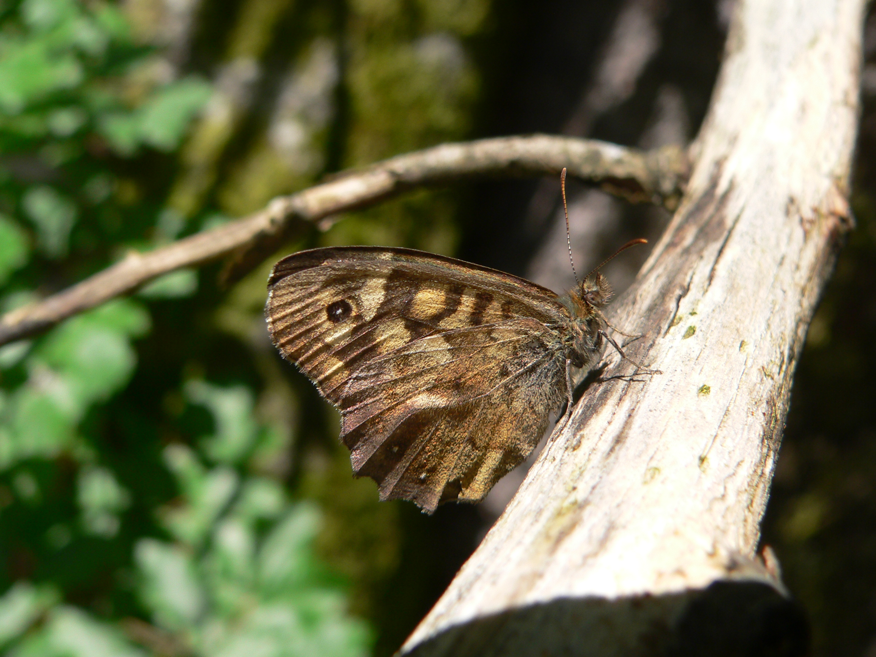
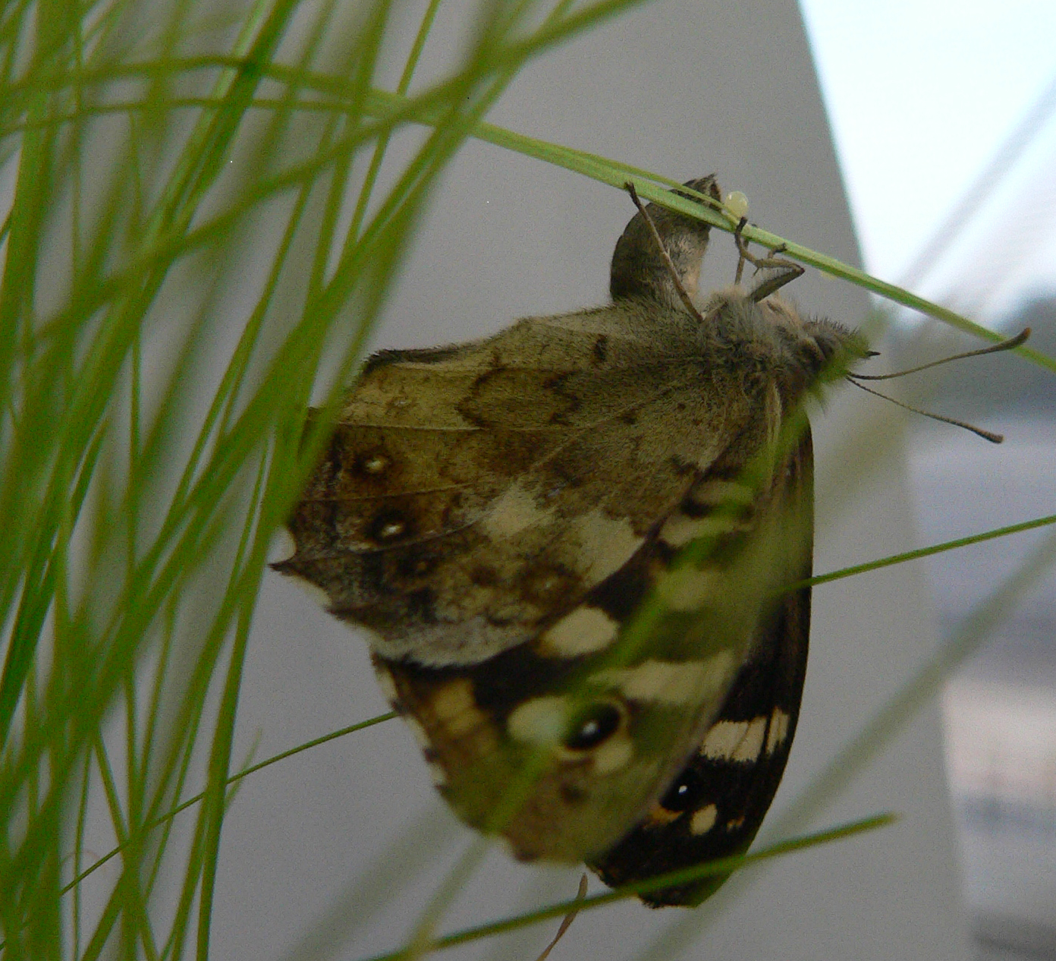
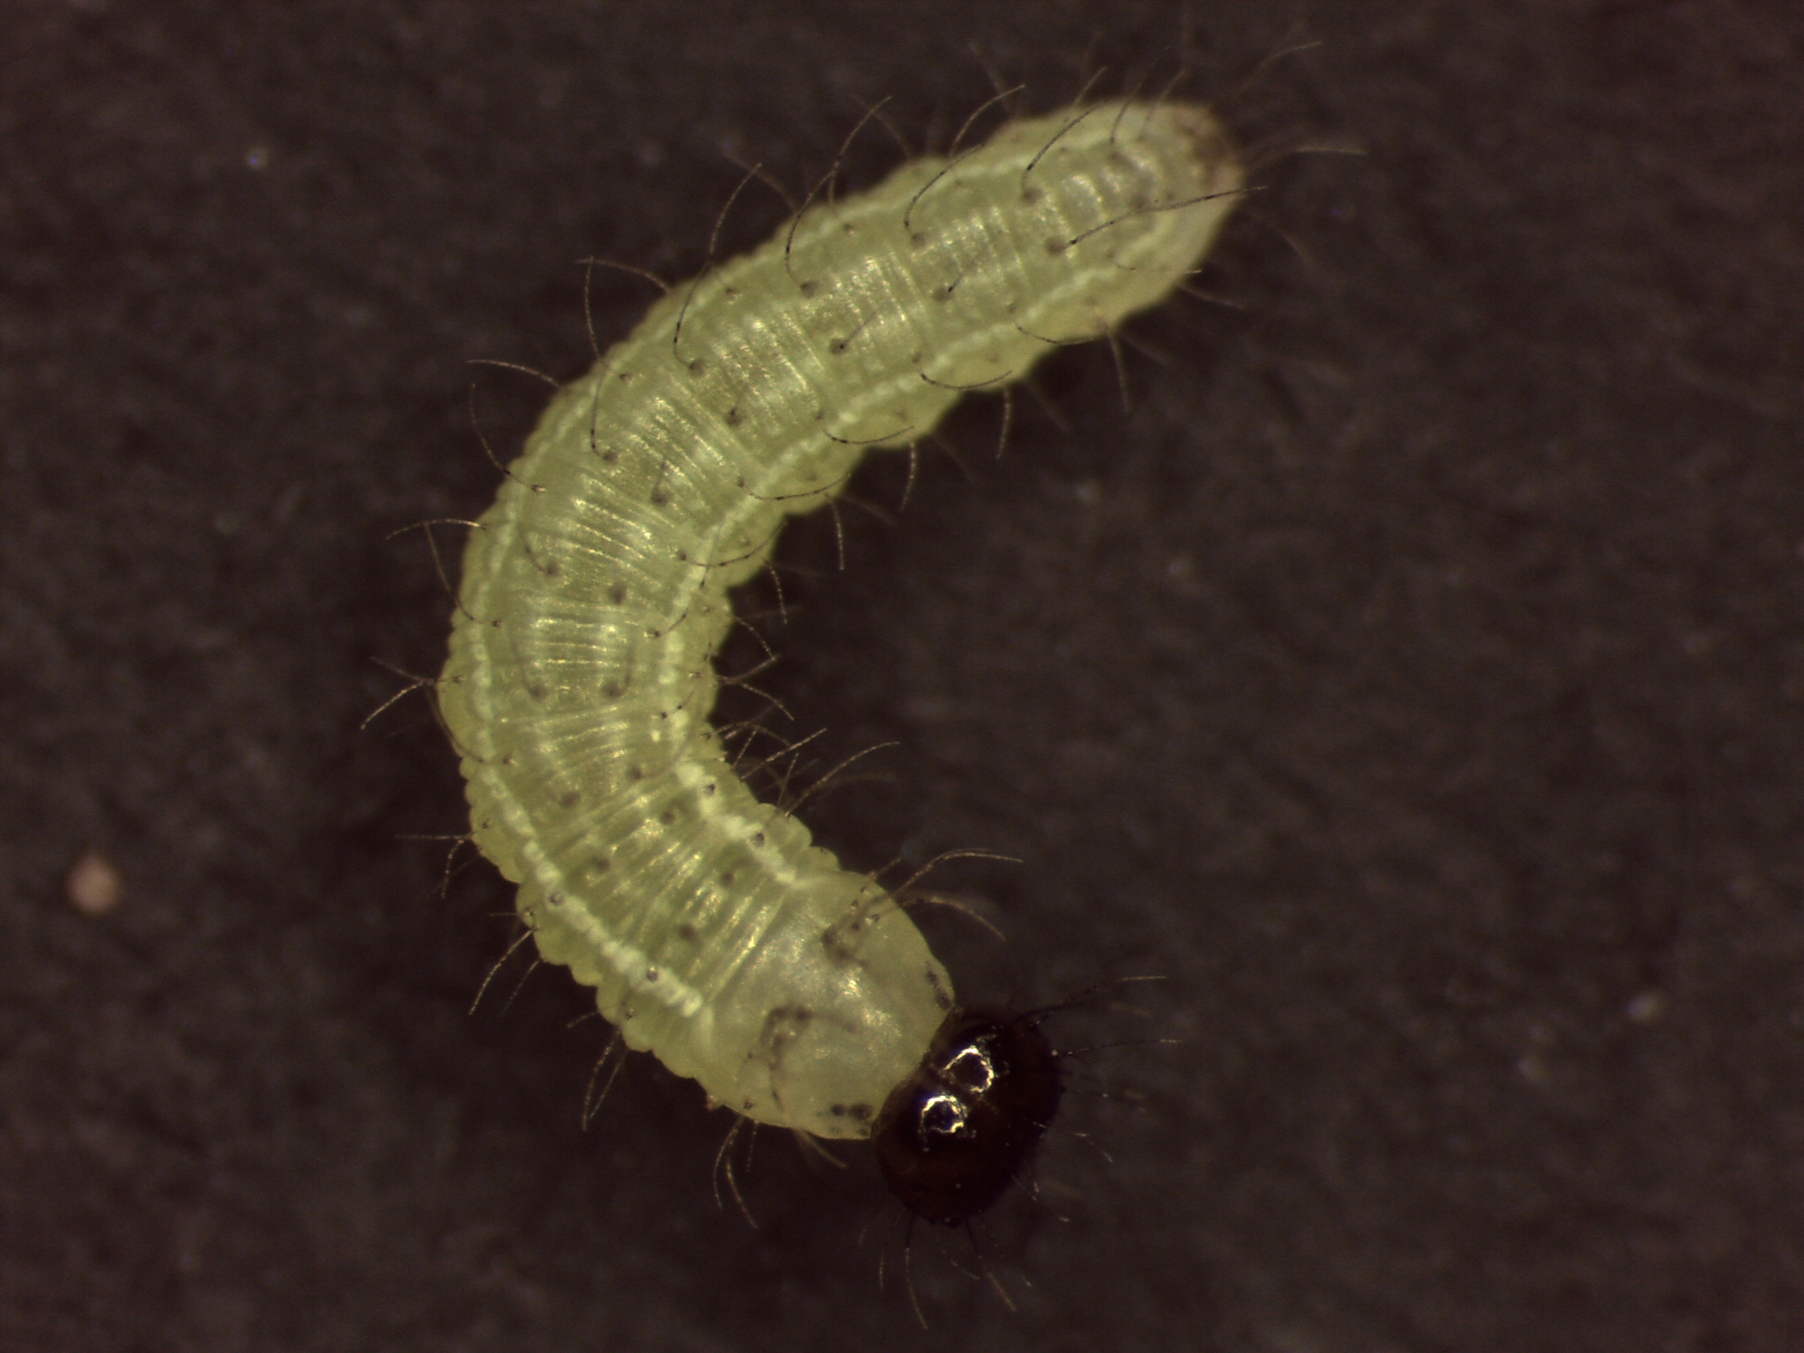
Butterflies and moths have four stages in their life cycle:
Egg
Caterpillar
Pupa
Adult
Changing shape through these four stages of the life cycle is called metamorphosis
Most butterfly and moth caterpillars only eat plants. Some adult butterflies and moths eat nectar from plant flowers
A suitable habitat needs to have food for both the caterpillar and adult life stages
Adult
Egg
Pupa
Caterpillar

Slide 4
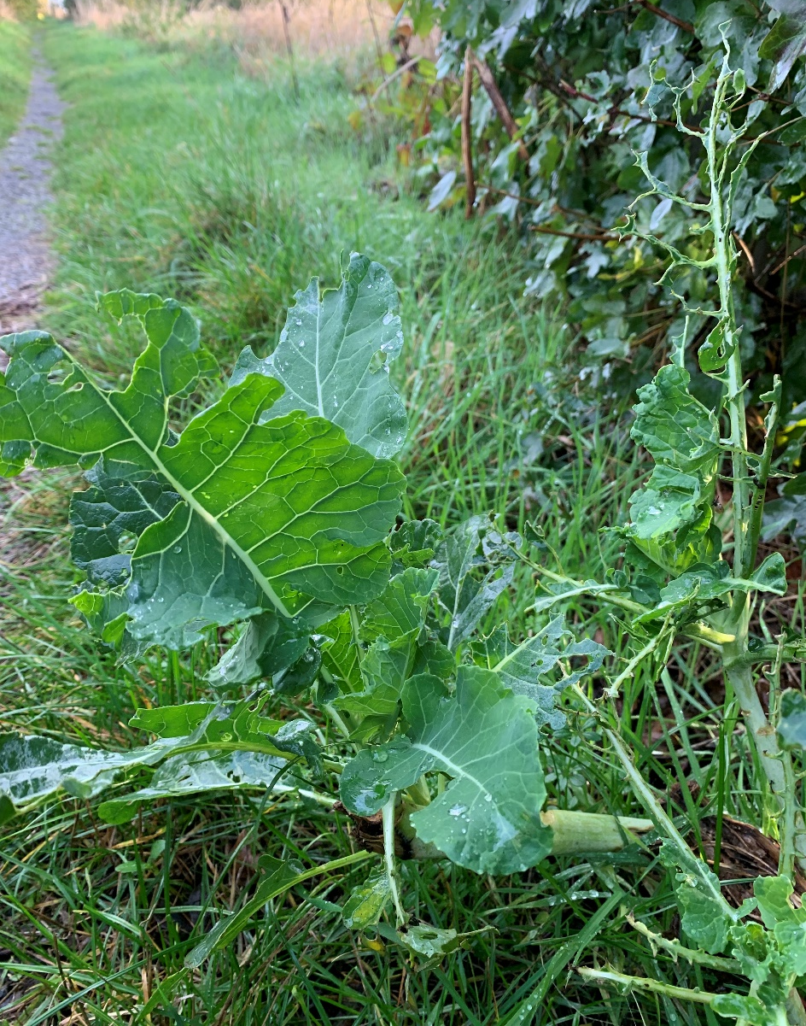
In some habitats, humans grow plants e.g. for food
Sometimes moth and butterfly caterpillars eat these plants
Humans think of these caterpillars as pests
Humans have made chemicals to can get rid of these unwanted caterpillars
These chemicals are called pesticides
A pesticide specifically made to kill insect pests is called an insecticide

Slide 5
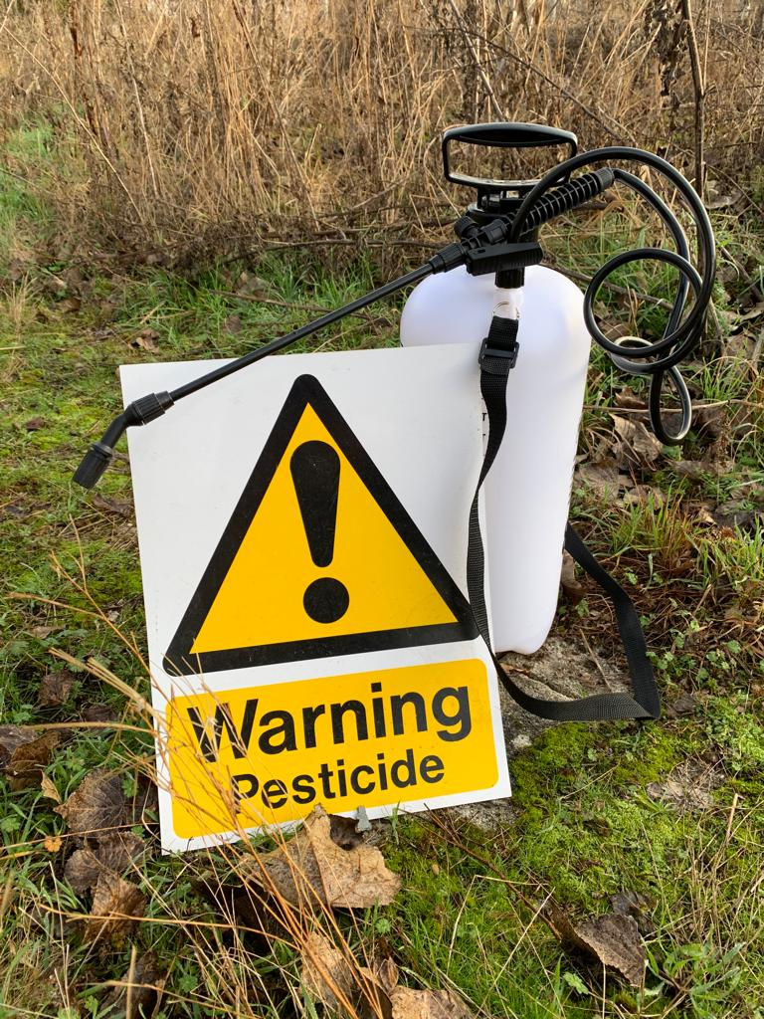
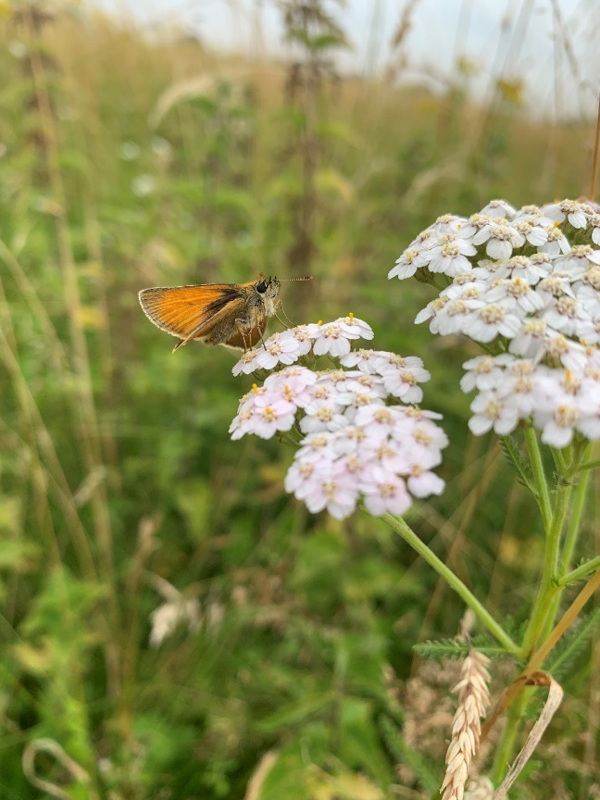
Using pesticides is important in farmlands
But pesticides can also kill caterpillars who don’t eat the crops, but just live nearby to the pests
These caterpillars play an important role in nature:
As food for other animals
And when they are adults, as pollinators of plants
So we need to use pesticides carefully to try to protect these non-pest caterpillars from harm
All images by Melanie Gibbs and Casper Breuker

